Slide 1
Start of presentation

Slide 2
Sponsors: Global Azure 2024 – Toronto

Slide 3
On-Premises to Azure Cloud: .NET Web App Journey
Callon Campbell Microsoft MVP | Azure
@flying_maverick

Slide 4


About me
Callon Campbell
Azure Architect | Developer
Adastra
Microsoft MVP | Azure (2018-2024)
25 years enterprise development with Microsoft technologies – .NET (C#), Azure, ASP.NET, Desktop, SQL, and Mobile
Passionate about serverless and cloud-native application development, with focus on app migration and modernization, app integration and data analytics
Blogging at https://TheFlyingMaverick.com, and on @flying_maverick
Speaker at community events and meetups
Organizer of “Canada’s Technology Triangle .NET User Group” in Kitchener, Ontario

Slide 5
Agenda
Why migrate to Azure
Azure App Service
App migration journey
Demos
Azure Platform Accelerators
Q&A

Slide 6
Why migrate to Azure

Slide 7






Why migrate to Azure?
Optimized costs
Backup, recovery, and failover
Flexibility and scalability
Compliance
Enhanced security
Simplified management and monitoring
and many more…
Notes:
Cost:
Azure allows you to save money by paying only for the cloud resources you actually use.
Optimize workloads for efficiency and cost-effectiveness.
Pay only when you use resources occasionally.
Flexibility:
Adjust resources instantly based on demand spikes or decreases.
Run workloads closer to users using Azure’s global network of datacenters.
Security:
Azure offers built-in security features and tools to protect your applications and data.
Automatic security patching in many cases.
Backup:
Easily back up and recover your apps with Azure.
Store backups in different geographic regions for extra protection.
Compliance:
Azure provides solutions for compliance requirements in various industries (finance, healthcare, government, etc.).
Management:
Use a single dashboard to manage and monitor all your resources.
Leverage Azure services for insights and analytics related to your apps.

Slide 8
Why migrate to Azure
Azure supports all approaches and business priorities
Control
Simplicity
Infrastructure as a Service
Retain full control over the operating system in a cloud migration
Containers
Manage and scale containerized applications with ease
Platform as a Service
Offload infrastructure and operating system management to the cloud
Low code
Create a modern line of business apps with minimal coding
DevOps
Shorten the systems development life cycle and provide continuous delivery with high software quality
Notes:
On the left you retain more control and as we move to the right the responsibilities is shifted over to Azure.
IaaS – VMs
Containers – AKS and ACA
PaaS – App Service and Function Apps
Low code – Power Platform

Slide 9
Why migrate to Azure
Azure supports all approaches and business priorities
Control
Simplicity
Infrastructure as a Service
Retain full control over the operating system in a cloud migration
Containers
Manage and scale containerized applications with ease
Platform as a Service
Offload infrastructure and operating system management to the cloud
Low code
Create a modern line of business apps with minimal coding
Many apps can migrate with minimal or no required changes

Slide 10
Azure App Service

Slide 11
What is Azure App Service
Migrate your web applications using a secure, managed solution
Fully managed
Optimize costs by offloading infrastructure management
Take advantage of the cloud to increase agility​, and improve security and reliability
Deliver more innovative products
Deploy with confidence
Scale
Compliant
Secure
Notes:
Azure App Service is a fully managed platform for your web apps.
Microsoft manages the infrastructure, operating system updates, load balancing, and scale-up/scale-down logic as needed – allowing you to take advantage of the cloud to increase agility and improve security and reliability.
Autoscale
Deployment slots (live testing, staging – where manual or automated tests can be performed. Then swap the slots or quickly rollback)
Deliver more innovative products.

Slide 12
Migration journey

Slide 13
App Migration and Modernization Journey
Lift and Shift
Monolith
IaaS
Cloud Optimized
Monolith
PaaS
Cloud Native
Microservices
PaaS, Serverless
Rehost
Re-platform | Refactor
Re-architect | Rewrite

Slide 14
App Migration and Modernization Journey
Modernization
Cloud Native
Microservices
PaaS, Serverless
Cloud Optimized
Monolith
PaaS
Rearchitect/Rewrite
Lower engineering complexity and cost
Lift and Shift
Monolith
IaaS
Replatform/Refactor
Rehost
Increased Agility – Faster Time to Market – Lower Total Cost of Ownership – Greater IT Simplification
Notes:
On the Y axes, as you move up, you lower the engineering complexity and cost.
On the X axes, towards the right we have faster time to market, lower cost of ownership, and greater IT simplication.

Slide 15

How migration process looked like before?
1. Business decision
2. Overall evaluation
3. Engineering work
moving apps to Azure

Slide 16


App Migration journey can be easy with…
App Migration can be easy with the right tools, accelerators, and organizational alignment.
Powerful App Migration Tooling Discovery | Assessment (Configuration and App Code) | Migration
Azure Platform Accelerators Landing Zone | Landing Zone Accelerators | App Patterns
Focus of
presentation

Slide 17
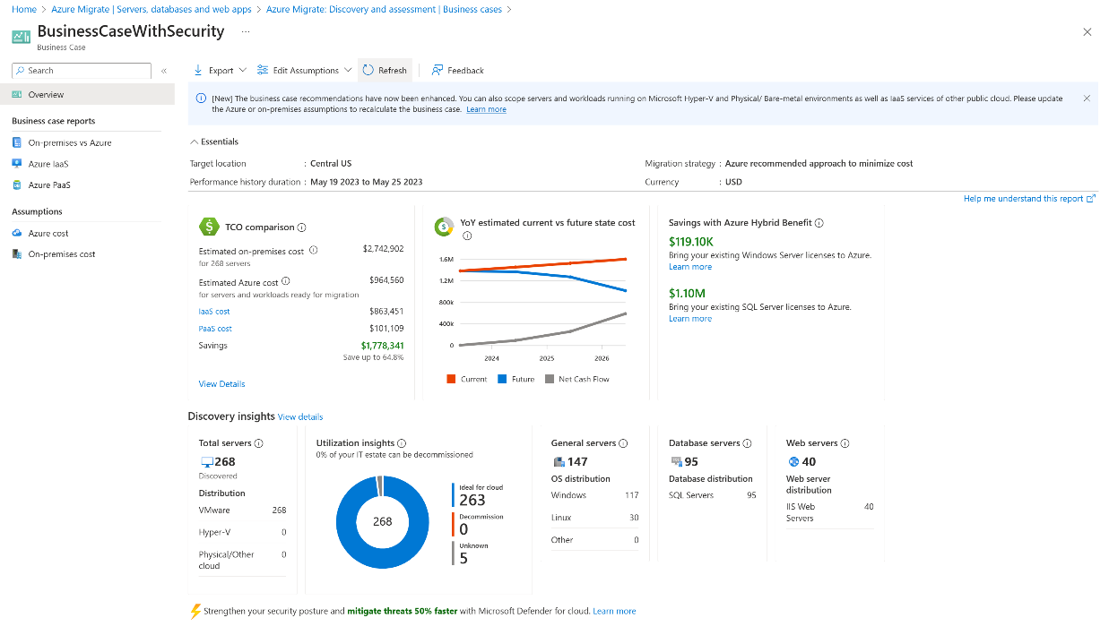
Azure Migrate
Easiest path to App Service.
Scenario: High-level VM config and large applications scan / discovery.
Benefits:
Discovery: Scans the entire portfolio of VMs, apps and their dependencies
Assessment: Discovers ASP.NET and Tomcat apps by it’s config files determines readiness for migration
Cost: Compare on-premises financial metrics with Azure
Migration: Conducts migration (if minimal or no code change required)
Notes:
Agent-based VM and application discovery
Large scale discovery of .NET and Java Tomcat web apps deployed to VMware/ Hyper-V/physical server environments​
Large scale assessment of .NET web apps deployed to VMware/Hyper-V/ physical server environments​
Large scale migration of .NET web apps to Azure App Service​ on VMware environments
Azure Migrate Project
Azure Migrate is a hub for matters related to migration.
Captures information about all the servers and services that they hope to migrate to Azure.
Use the discovery and assessment to determine the scope of the migration efforts.
Plan, inform stakeholders, determine costs, track migration status.

Slide 18
Why perform an assessment?
Azure App Service Migration Assistant looks for incompatibilities between your on-premises web apps and what's supported on Azure App Service
Notes:
Determine use of low-level features of IIS
Port bindings
Protocols
Certificates
Location tags
ISAPI filters
Application pools
Authentication type
Frameworks (asp.net and php)
Virtual directories

Slide 19
Application and code assessment for .NET
Assess application-level cloud readiness for re-platforming
Available for .NET or Java applications
VS extension aka.ms/appcat/dotnet/vs
.NET CLI tool aka.ms/appcat/dotnet/cli
CLI for Java aka.ms/appcat/java
Scan source code, configuration, and binaries for potential issues
External dependencies, authentication systems, scalability concerns
Interactive compatibility report – exports to HTML, JSON, and CSV
Supports multiple Azure targets
Azure App Service
Azure Kubernetes Service
Azure Container Apps
Learn more at aka.ms/appcat/dotnet
Notes:
Enable dev teams to understand necessary work and where Azure-based alternatives may be needed

Slide 20










Examples of dependencies identified
Database
File system
Network resources
Authentication
Windows Identity
SMTP
Message queues
Caching
Session state
Secret management
Non-HTTP protocols
Application Request Routing

Slide 21

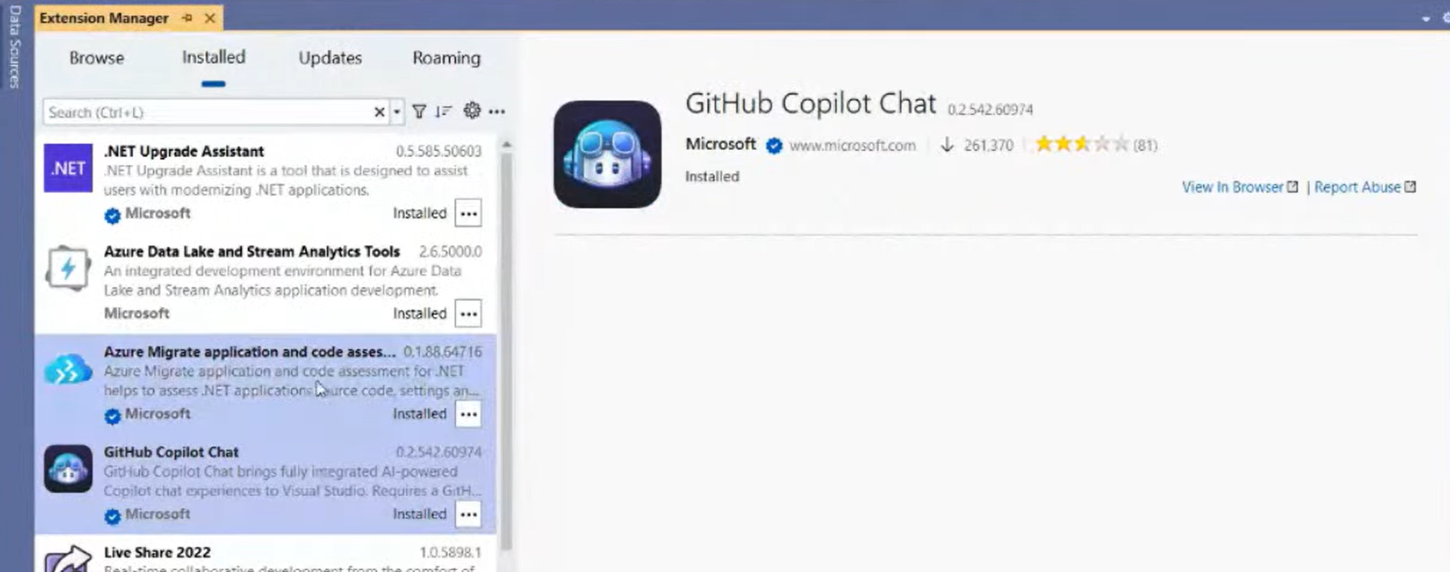
Setup and usage
Visual Studio Extension
Right click and select “Re-platform to Azure”.
Select “New report” and follow prompts.
Reports can be exported to HTML with the “export” button.
If GitHub Copilot Chat is installed, you can interact with Copilot as part of the assessment.
Command line
dotnet tool install –g dotnet-appcat
appcat analyze

Slide 22




End-to-end migration with Azure
ASP. NET Web App
On on-premises
PowerShell Scripts to Discover and Assess (Configs) .NET web apps
http://aka.ms/appmigrate
Application and Code Assessment Toolkit (Visual Studio Extension) to assess code readiness for re-platforming .NET web apps to Azure App Service
http://aka.ms/appcat
PowerShell Scripts to Migrate .NET web apps to Azure App Service
http://aka.ms/appmigrate
ASP. NET Web App
On Azure App Service

Slide 23
Demos
Azure Migrate
Application and code assessment for .NET

Slide 24
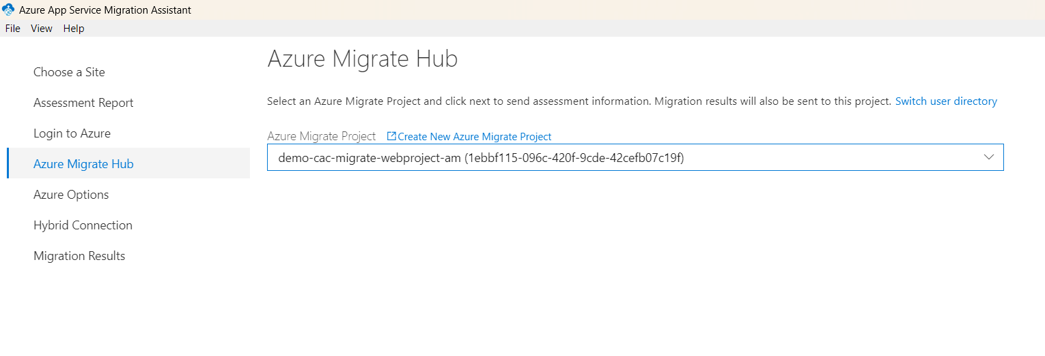

Slide 25
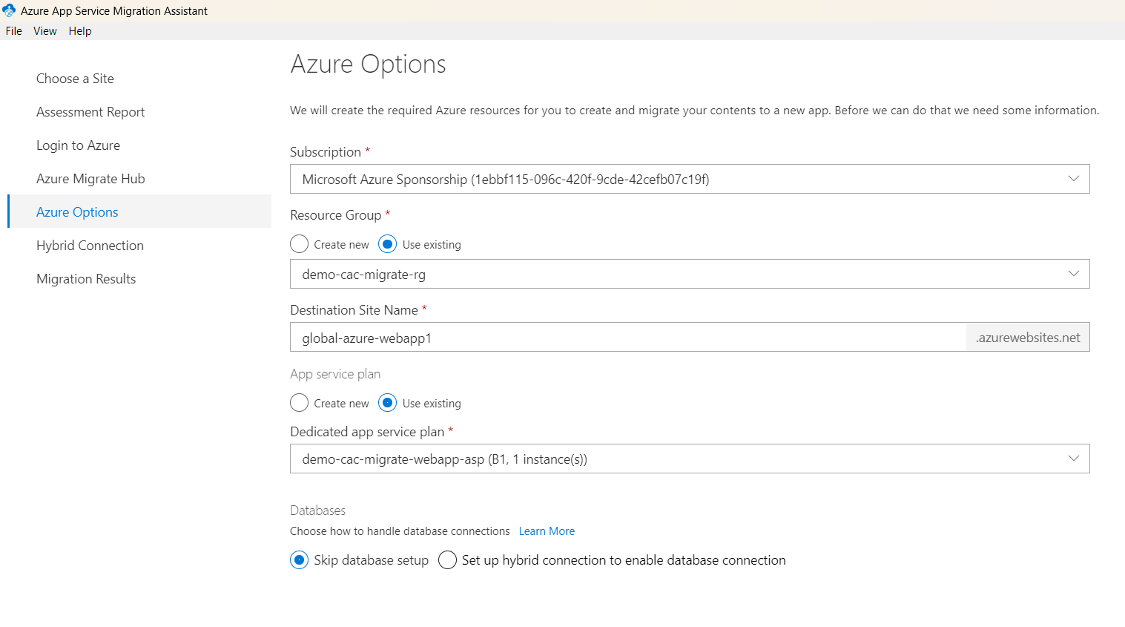

Slide 26
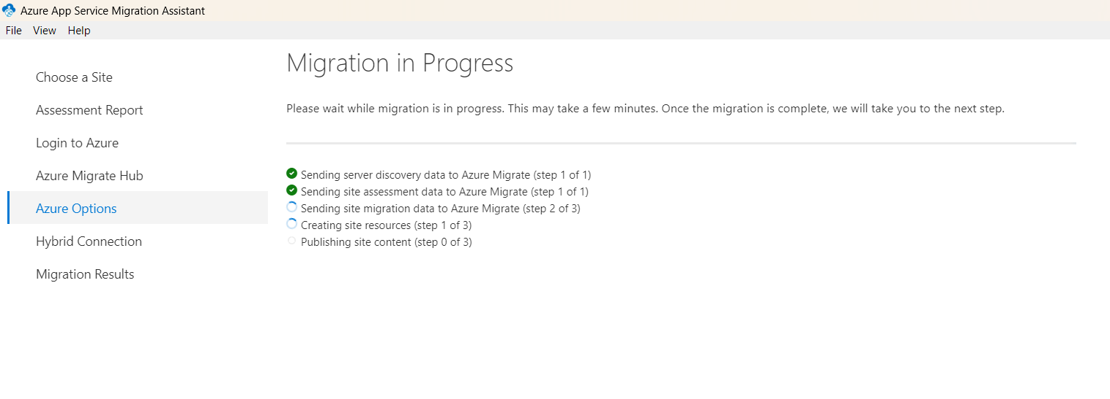

Slide 27
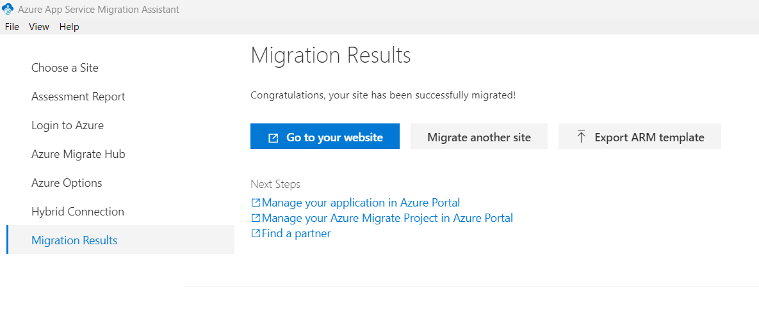

Slide 28
Sites
Old http://localhost/eShopLegacyWebForms/
New
https://global-azure-webapp1.azurewebsites.net/eShopLegacyWebForms/

Slide 29
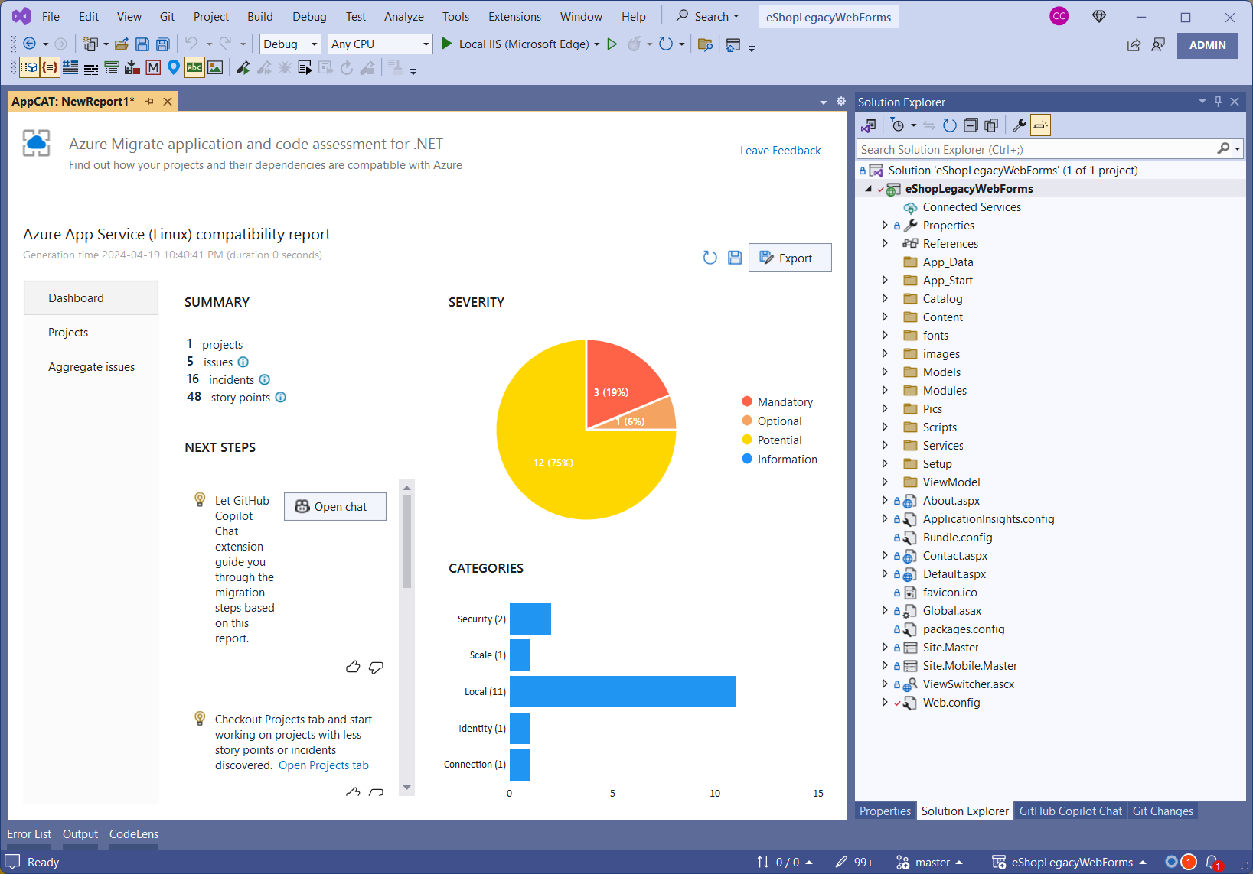

Slide 30
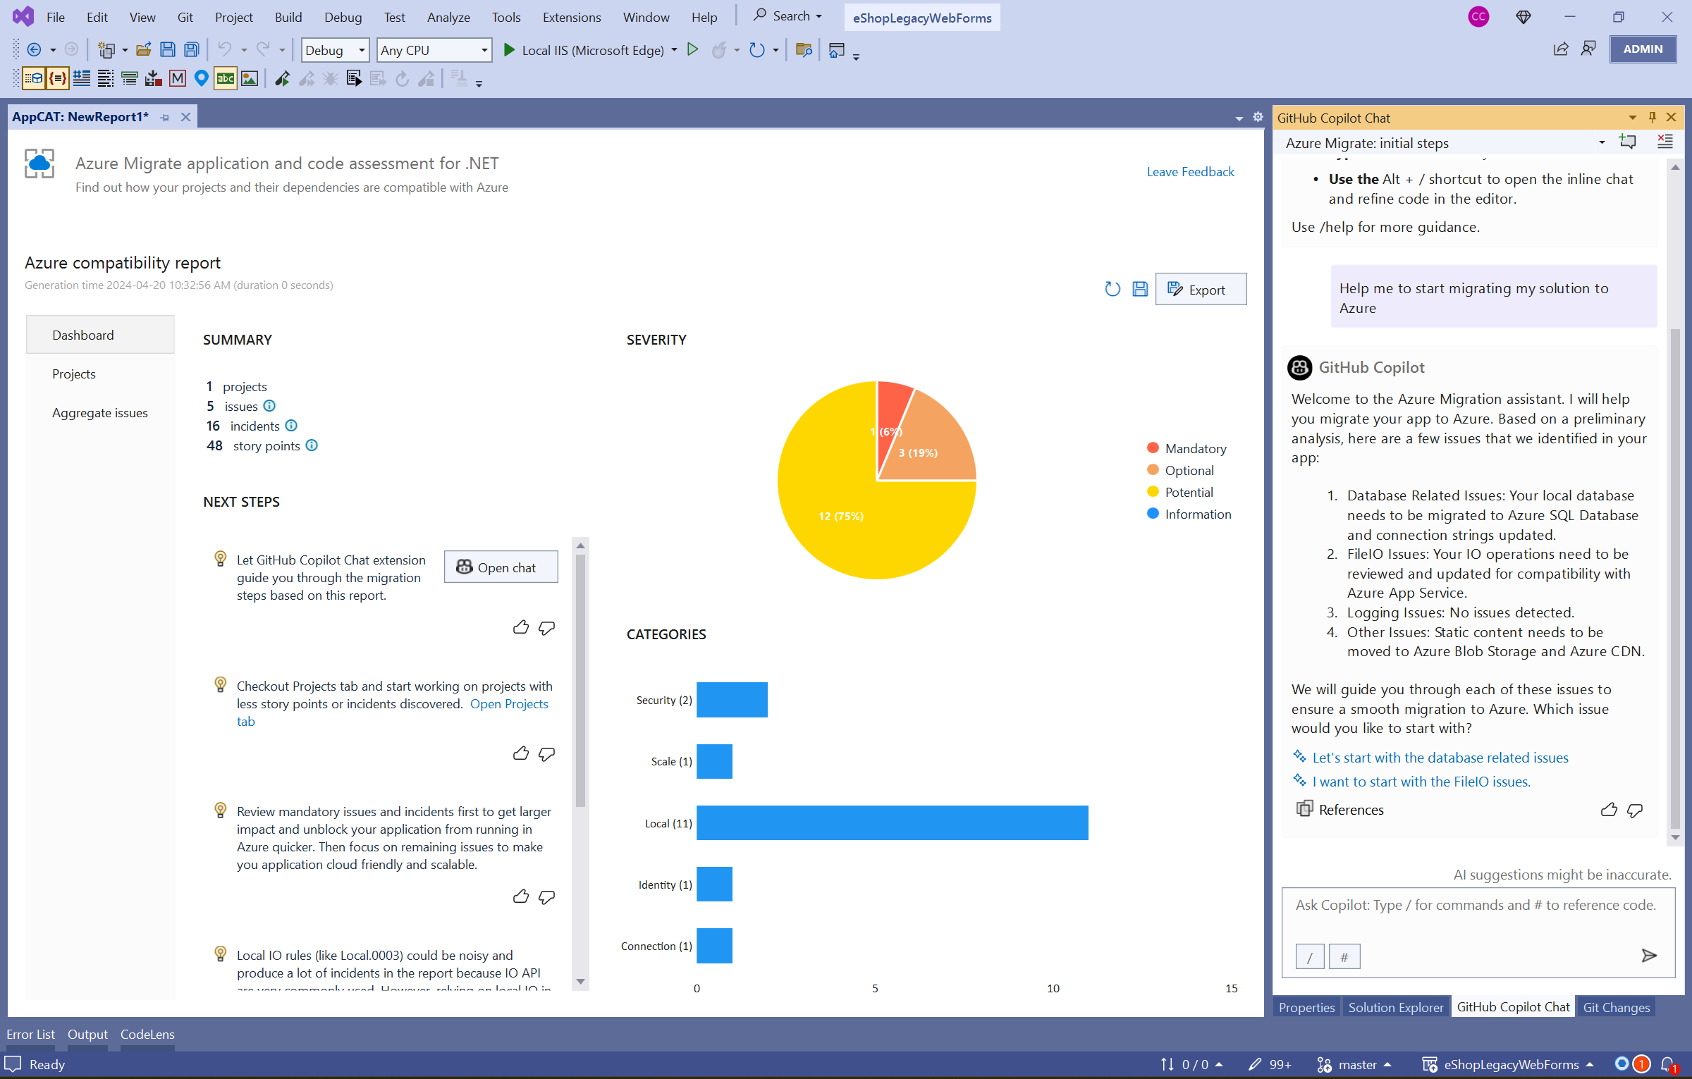

Slide 31
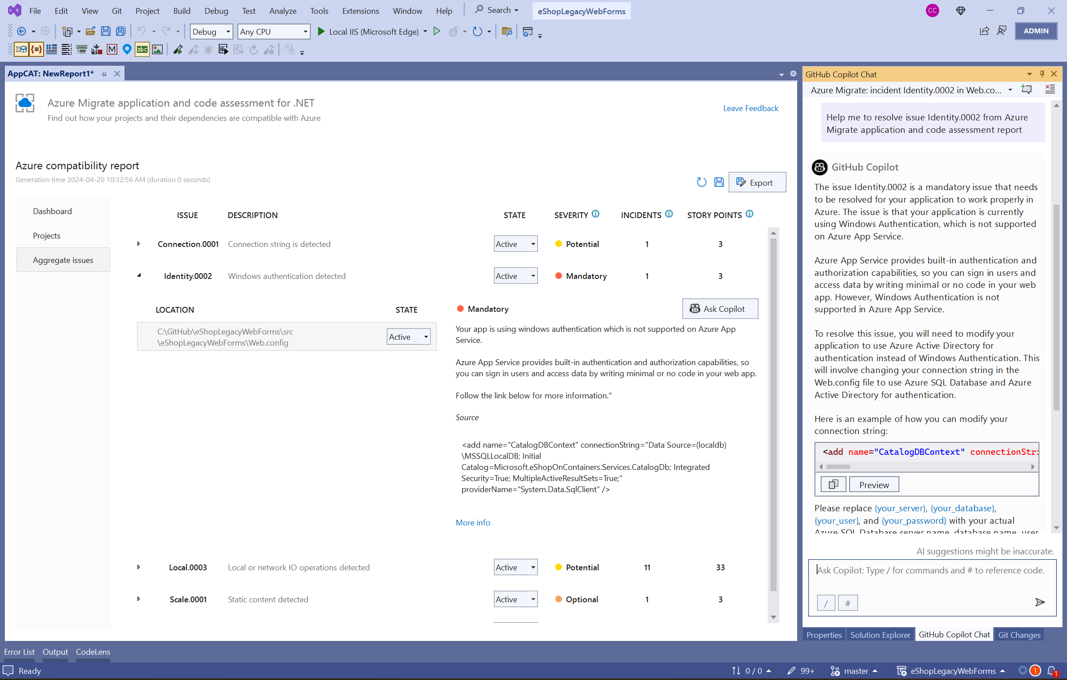

Slide 32
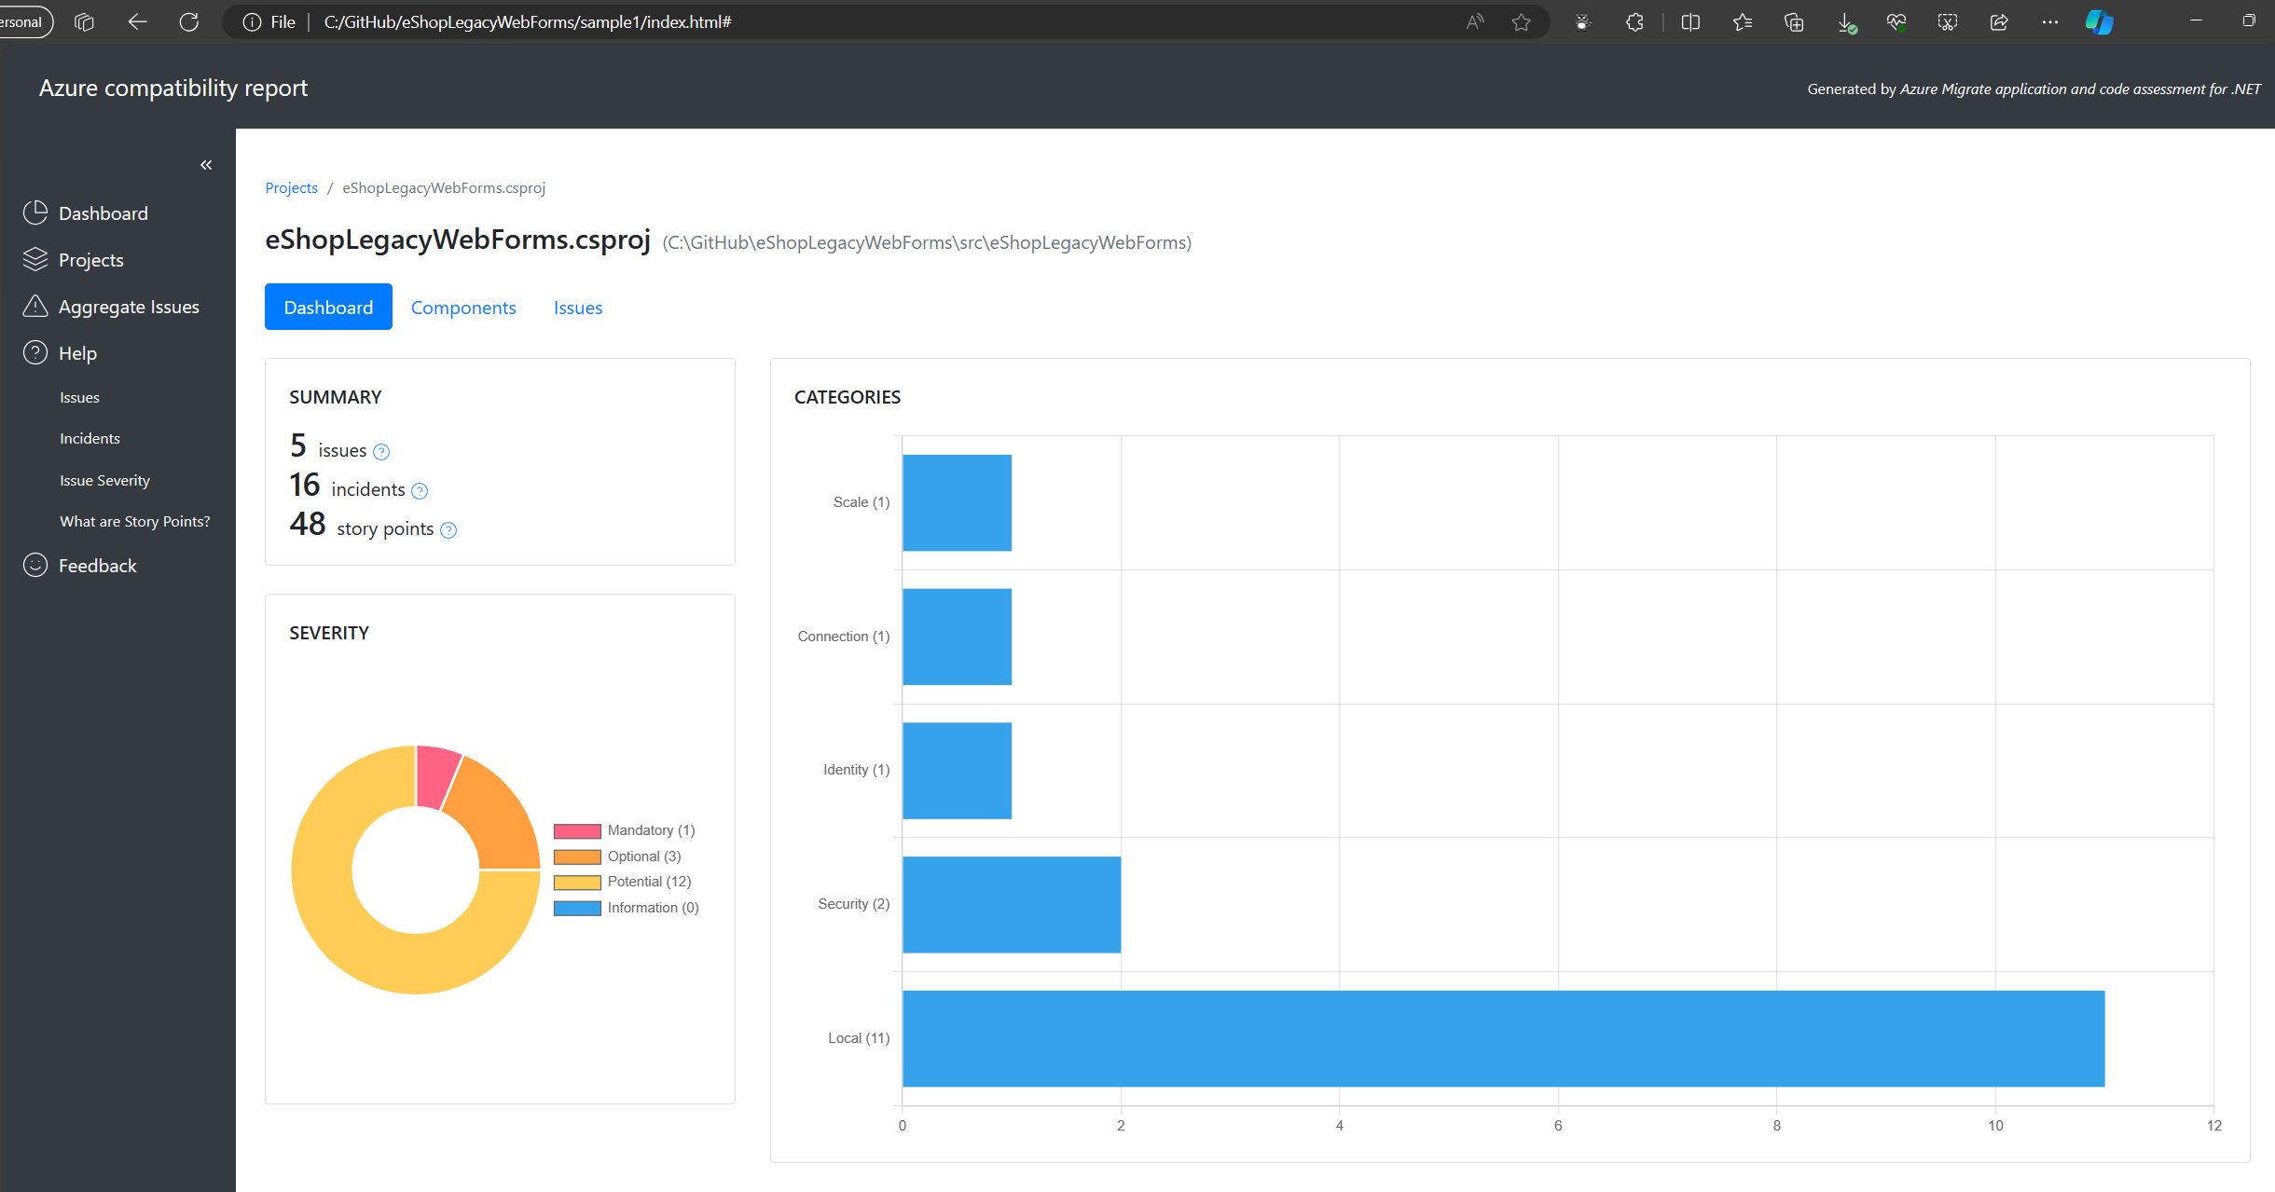
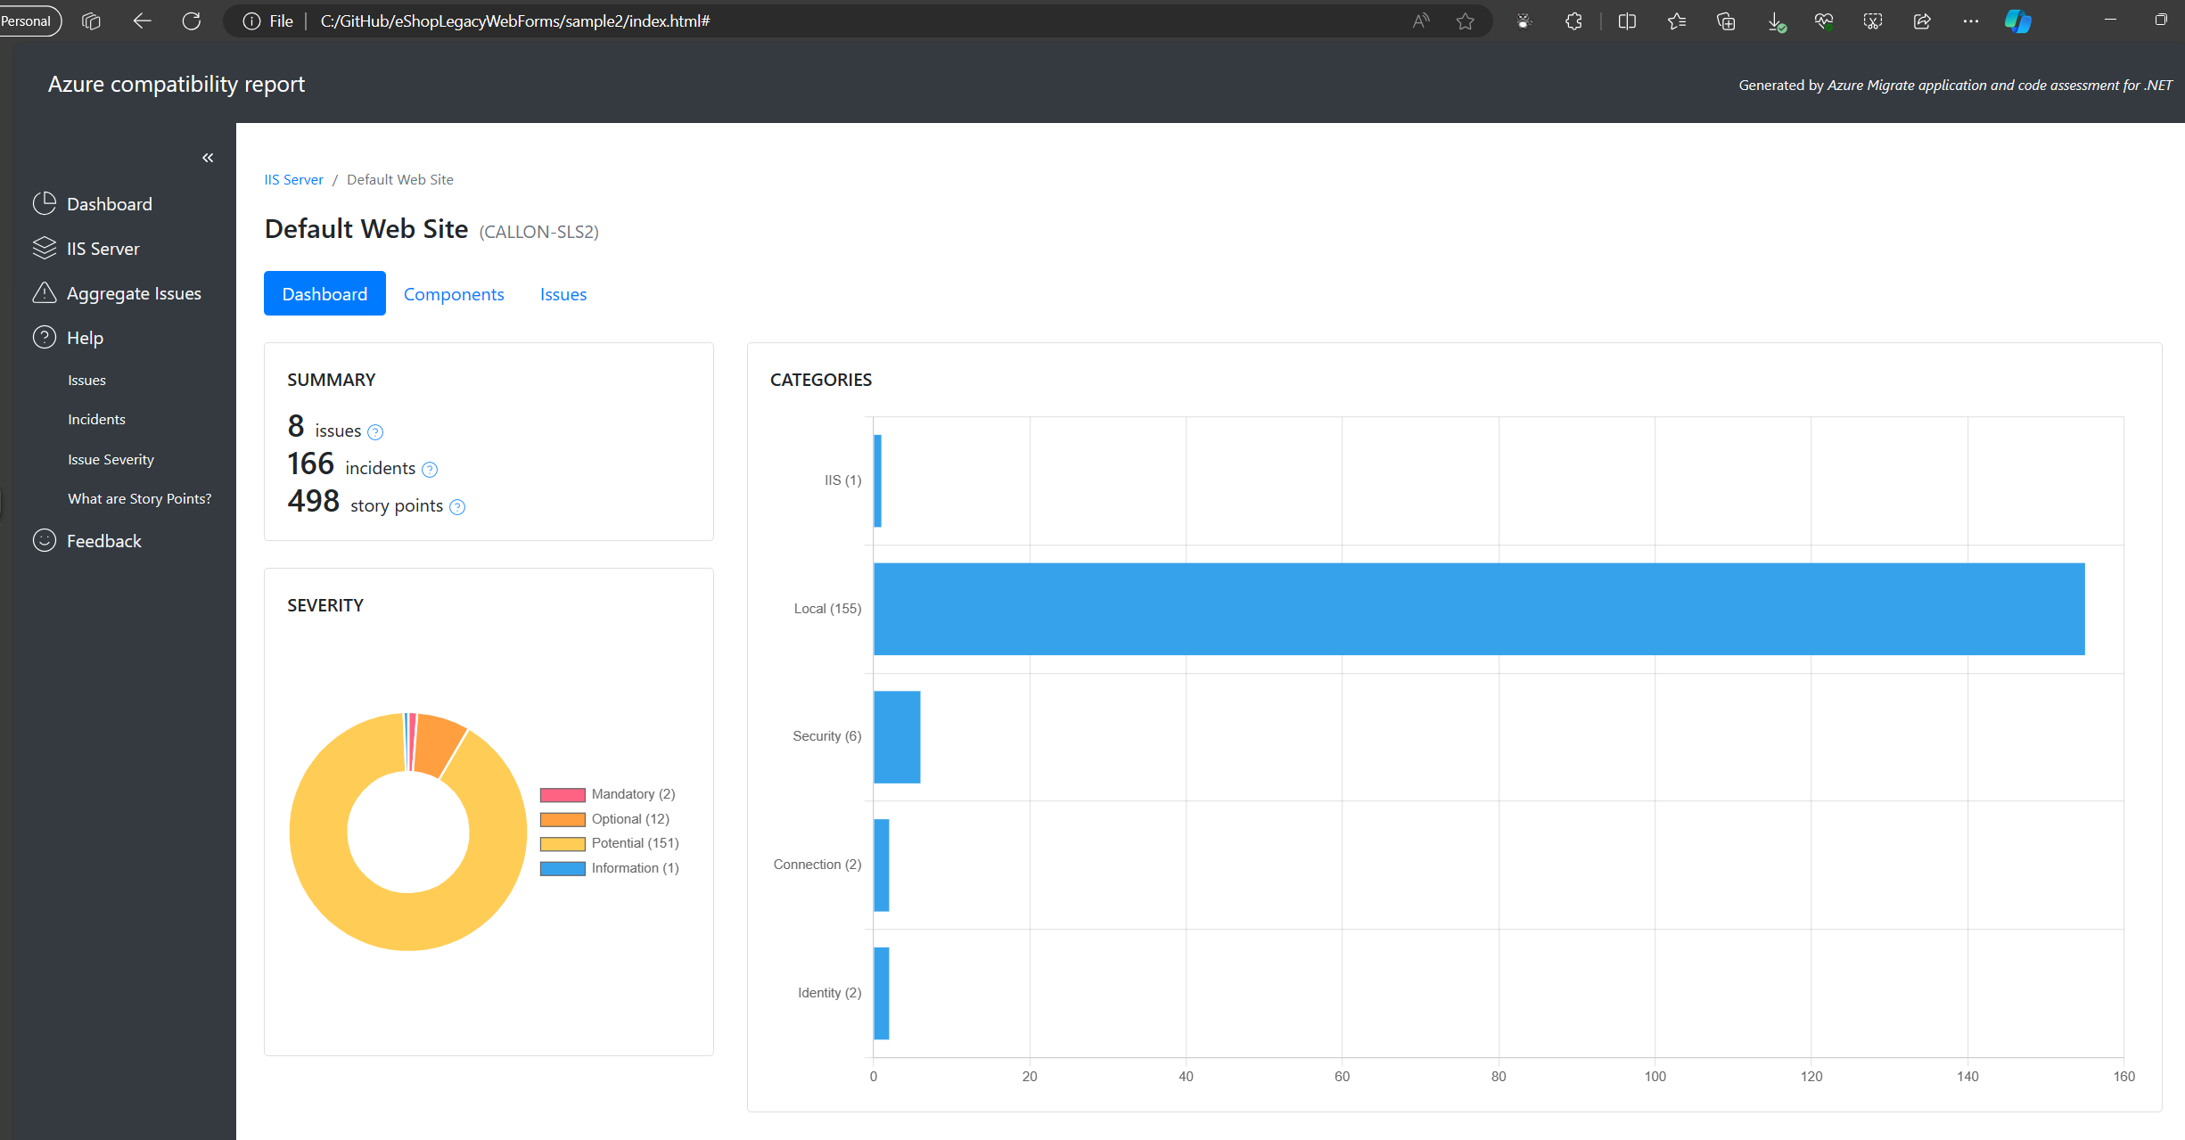

Slide 33
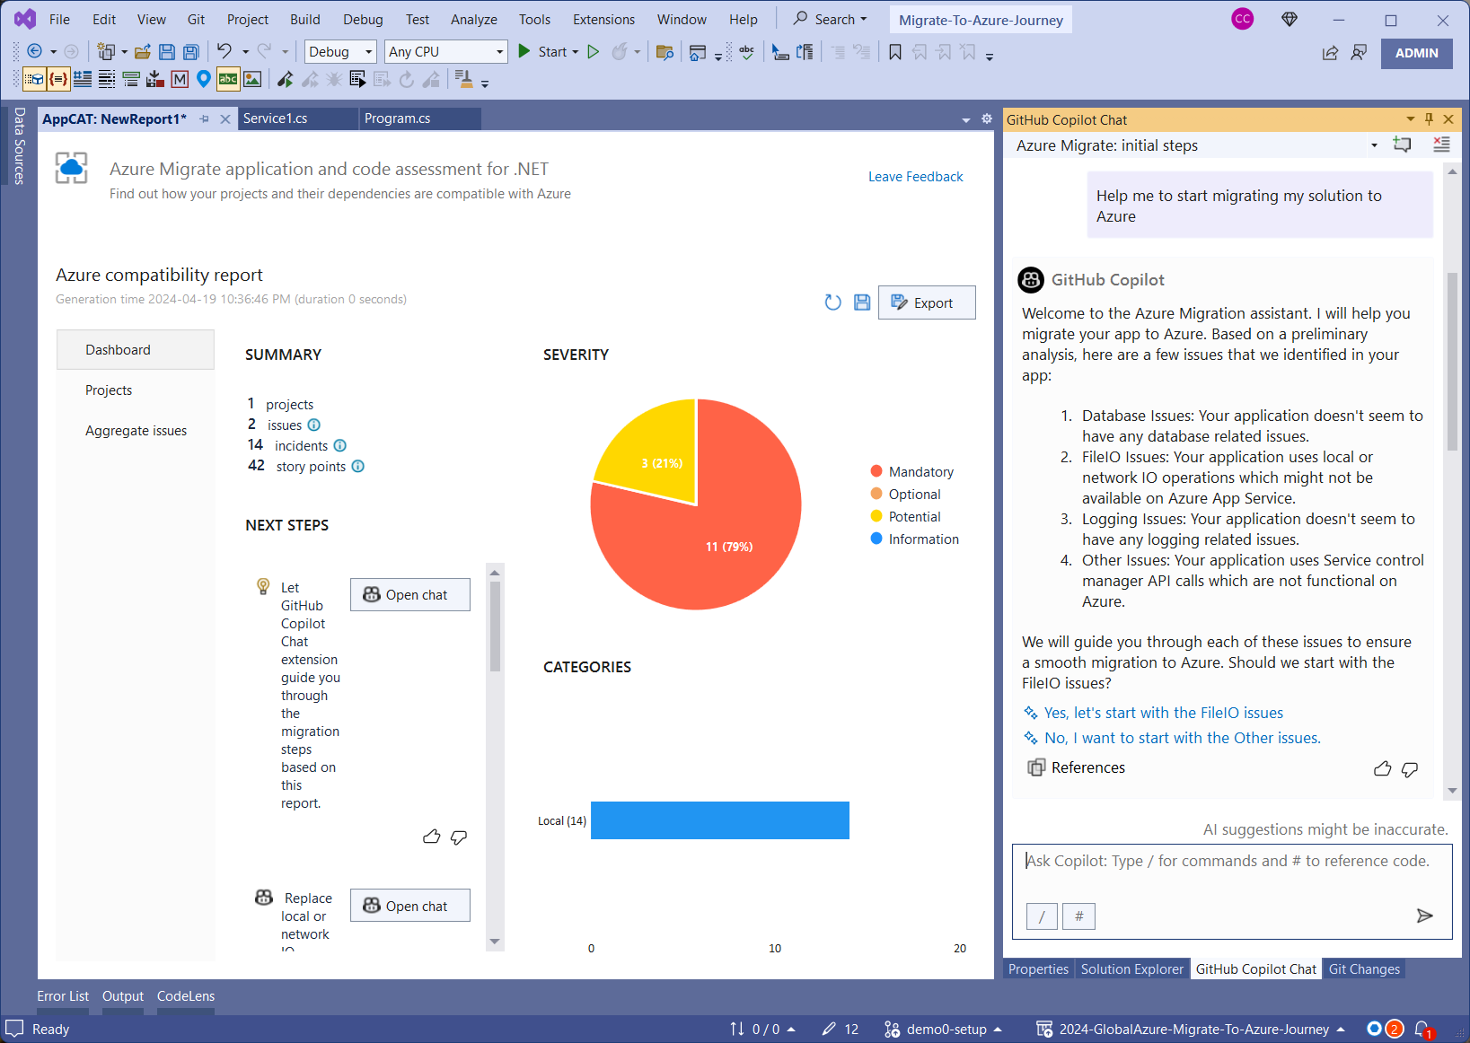

Slide 34
Azure App Service with Windows Containers
If your app cannot be migrated directly to App Service, consider App Service using Windows Containers.
Enables usage of the GAC, COM components, MSIs, full access to .NET FX APIs, DirectX, and more.
https://learn.microsoft.com/en-ca/dotnet/azure/migration/app-service
Notes:
Having server or custom dependencies, like on File System, PDF tools, GAC assemblies, COM+ or MSI installations on OS, means that the web app cannot work directly on Azure App Service.
It’s recommended to use Azure App Service with Windows Containers in this situation.
https://learn.microsoft.com/en-ca/dotnet/azure/migration/app-service
https://techcommunity.microsoft.com/t5/apps-on-azure-blog/what-s-new-for-windows-containers-on-azure-app-service/ba-p/3883677

Slide 35
Azure Platform Accelerators

Slide 36
Azure Landing Zone Accelerators
Packaged guidance, architecture, and automation for scalable Azure workload deployment, based on industry-proven practices
Management
Governance
Identity & Access Management
Security
Network Topology & Connectivity
Platform Automation & DevOps
Notes:
Architectural guidance and reference implementations to accelerate deployment of Azure App Services at scale.

Slide 37
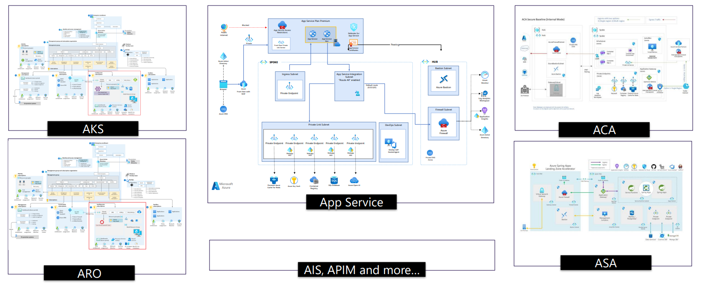
Azure Landing Zone Accelerators
aka.ms/LZA
Notes:
There are accelerators for many scenarios. Go to aka.ms/lza to learn more about each one.

Slide 38
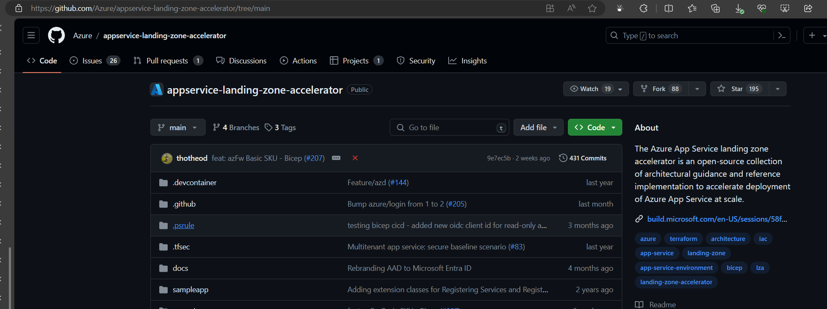
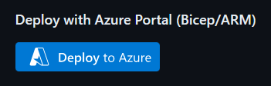
Azure Landing Zone Accelerators
Notes:
This repository provides both enterprise architecture guidelines and a reference implementation for deploying Azure App Service solutions in multi-tenant and App Service Environment scenarios. It includes best practices, considerations, and deployable artifacts for implementing a common reference architecture. You can click on the Deploy to Azure to quickly get started.
https://github.com/Azure/appservice-landing-zone-accelerator

Slide 39
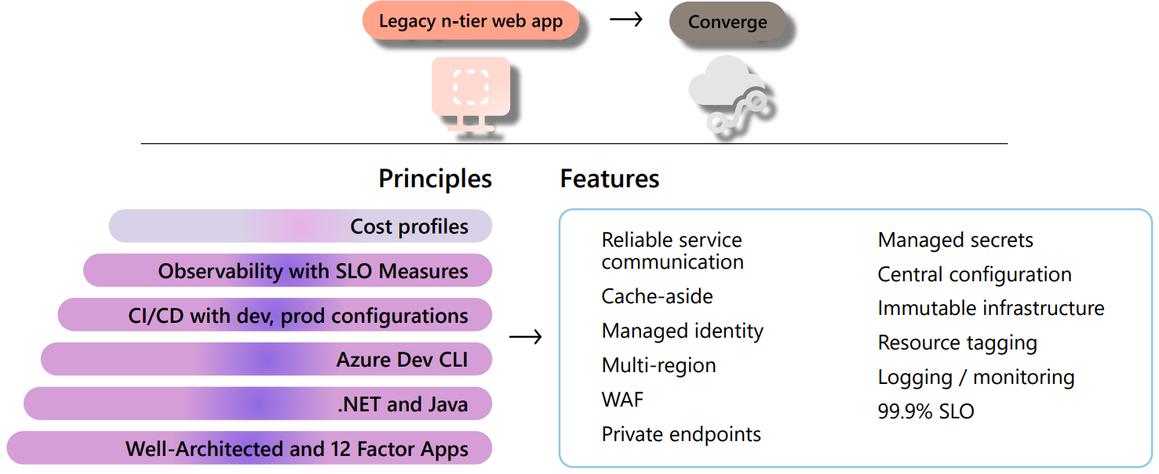
Reliable Web App Pattern
aka.ms/eap/rwa
Notes:
The Reliable Web App pattern aims to streamline the process of moving web applications to the cloud.
Provides a systematic method for quickly adopting cloud technologies for on-premises web applications.
Follow the Cloud Adoption Framework and establish a landing zone for their web applications.
Details strategies for replatforming your web application to ensure a successful migration to the cloud.
SLO – service level offering

Slide 40
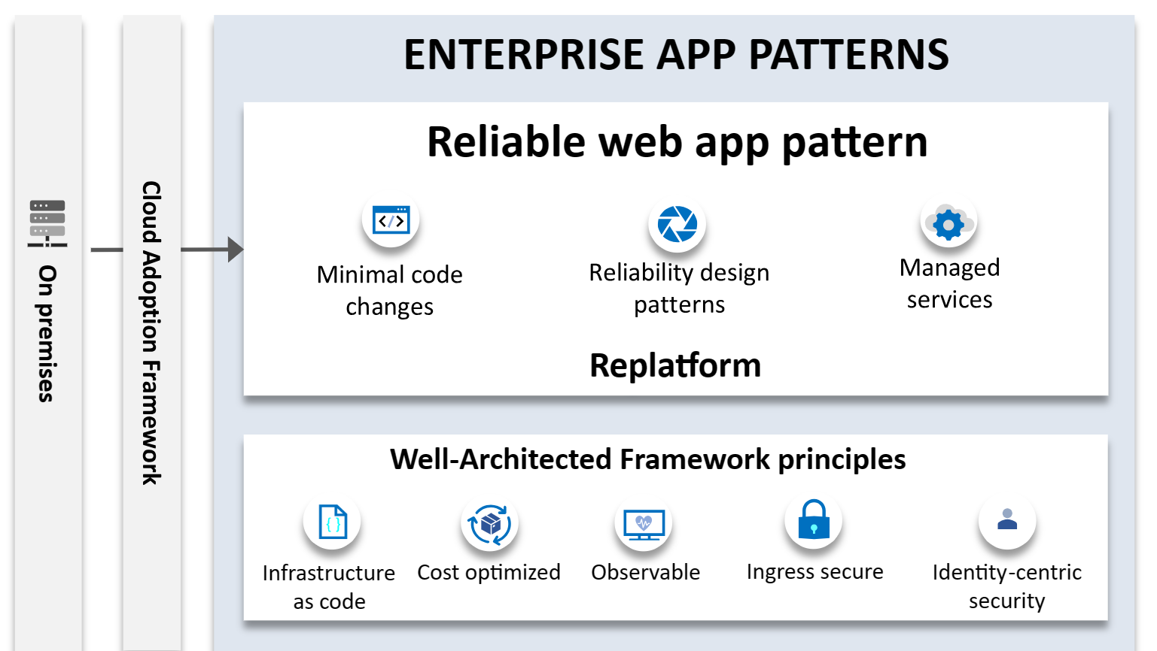
Notes:
Principles and implementation techniques
The Azure Well-Architected Framework is a design framework that can improve the quality of a workload by helping it to: Be resilient, available, and recoverable. Be as secure as you need it to be. The Well-Architected Framework establishes the overriding principles of the Reliable Web App pattern.
Implementation techniques
▪ Retry pattern ▪ Circuit-breaker pattern ▪ Cache-aside pattern ▪ Rightsized resources ▪ Managed identities ▪ Private endpoints ▪ Secrets management ▪ Bicep (.NET) and Terraform (Java) deployment ▪ Telemetry, logging, monitoring

Slide 41
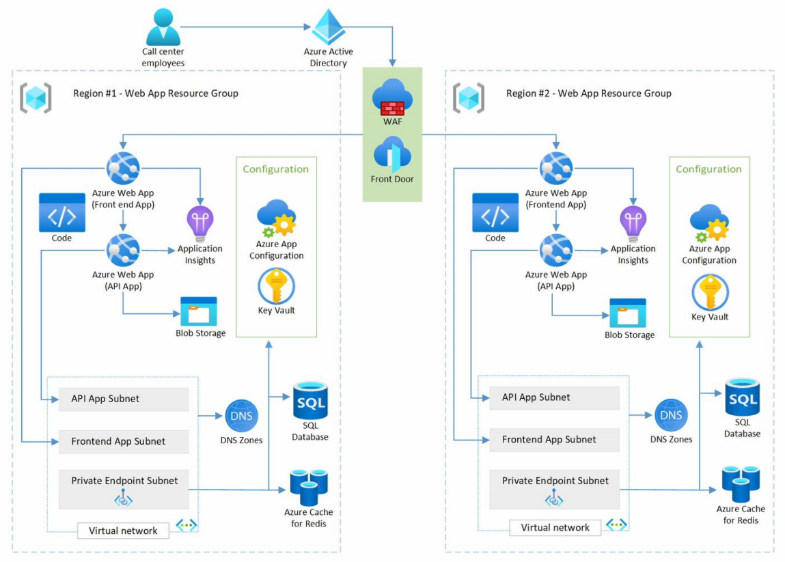
Notes:
Here is an architecture of a reliable web app taking into account enterprise app patterns.
It's important to note that the Reliable Web App pattern isn't a one-size-fits-all set of services or a specific architecture.
The unique needs of your business and the characteristics of your existing web application are crucial in determining the most suitable architecture and network topology.

Slide 42
Wrap up

Slide 43
What we discussed today
Azure Migrate
Application and Code Assessment for .NET and Java
Azure App Service
Application Patterns & Landing Zone Accelerators
Presentation available:
https://github.com/calloncampbell/2024-GlobalAzure-Migrate-To-Azure-Journey
Notes:
We looked at how you can leverage Azure Migrate to discover, assess and even automate the migration.
We looked at how the application and code assessment for .NET (and Java) can be used to go deeper on the code analysis and provide additional insights when migrating to App Service, AKS and ACA.
And finally we took a quick look at application patterns and landing zone accelerators which will help you be successful with your Azure migration.

Slide 44
Get started today!
Azure App Service aka.ms/ModernApps/AppService
Azure Migrate aka.ms/Azure/Migrate Use the Application and Code Assessment tool aka.ms/AppCat/dotnet Reliable Web Apps Pattern aka.ms/eap/rwa
Landing Zone Accelerators aka.ms/LZA
Azure for .NET developers https://learn.microsoft.com/en-ca/dotnet/azure/
Further Reading aka.ms/MigrateApps/checklist
Azure App and Data Modernization aka.ms/ModernApps
Apps on Azure blog aka.ms/ModernApps/Blogs
Notes:
https://learn.microsoft.com/en-us/training/modules/migrate-app-service-migration-assistant/

Slide 45




Let’s connect
Callon@CloudMavericks.ca
@Flying_Maverick
https://LinkedIn.com/in/CallonCampbell
https://GitHub.com/CallonCampbell

Slide 46
End of presentation

